Slide 1
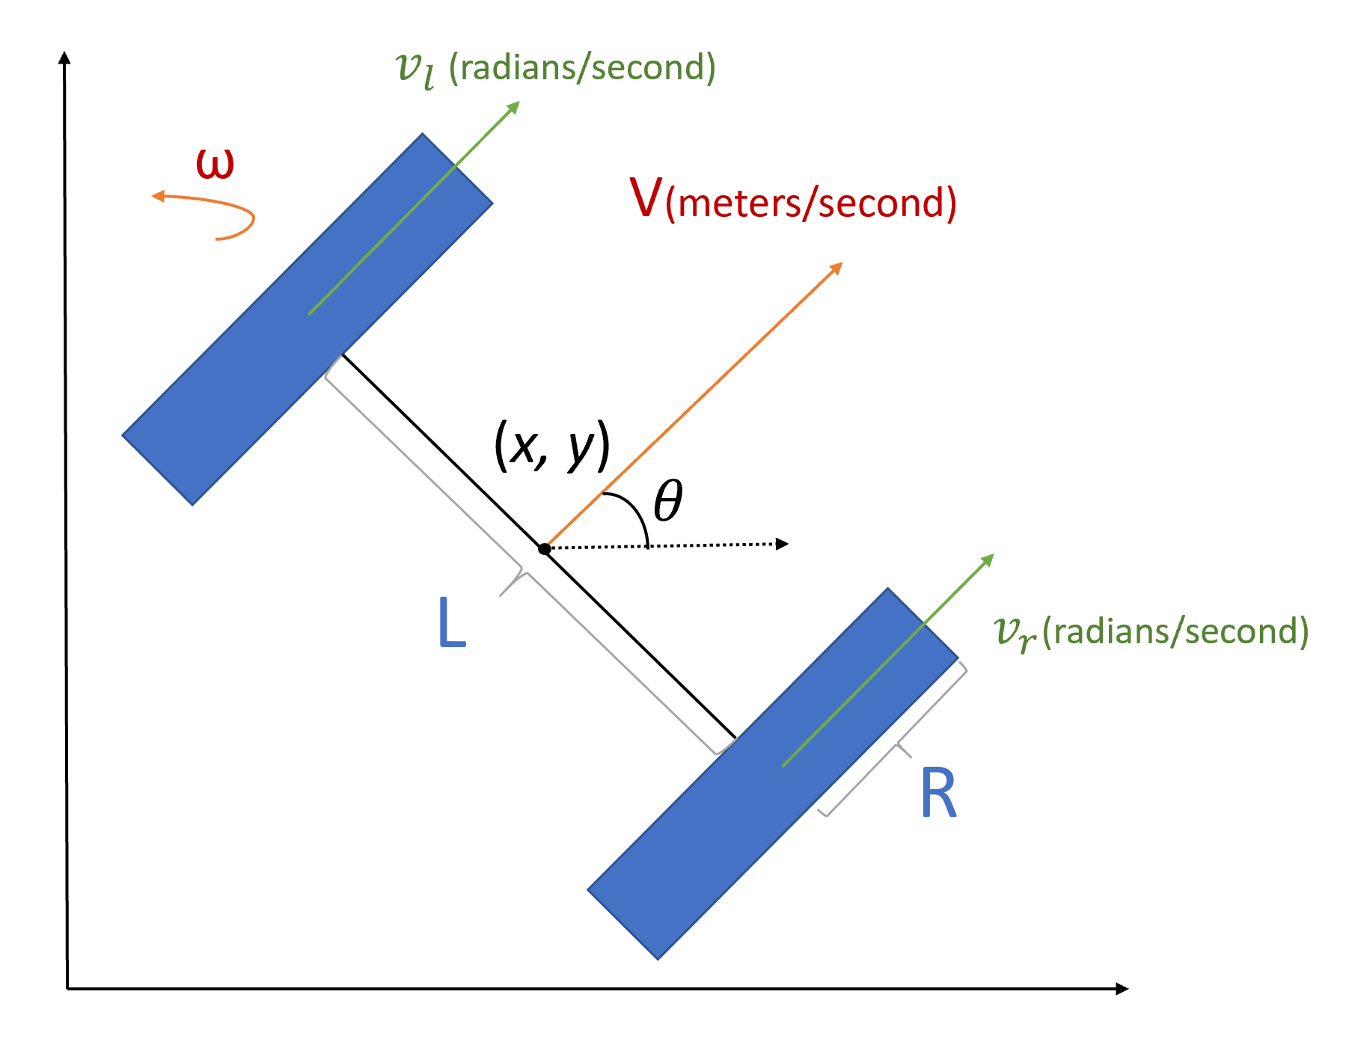
Differential Robot Simulator
Deficiencies Redesign
Gabriel Díaz
#121350
ME3082
Prof. Daniel Lozada

Slide 2
Deficiencies List
Data Structures module was not fully leveraged as a communication interface between modules.
Simulator relied on built-in configuration parameters rather than an external configuration.
Cause for derivative action instability was not determined.
Motor response time was not analyzed.
No quantitative stability analysis of the robot was performed.
Figures were not analyzed quantitatively.

Slide 3
Data Structures & Config
data_structures.py now contains structs that are passed by reference to object instantiations.
This ensures that all objects read the same relevant data.
Project directory now contains a config.yaml file as a user interface.
User may modify the config file to setup the simulation parameters, including figure sizes.

Slide 4
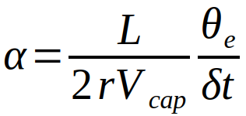
Derivative Action
The issues with derivative action were resolved.
The previous control system included an additional derivative in the orientation set point calculation.
Effectively, the previous controller was PDD², not PID.
Derivative action now no longer destabilizes the system.

Slide 5
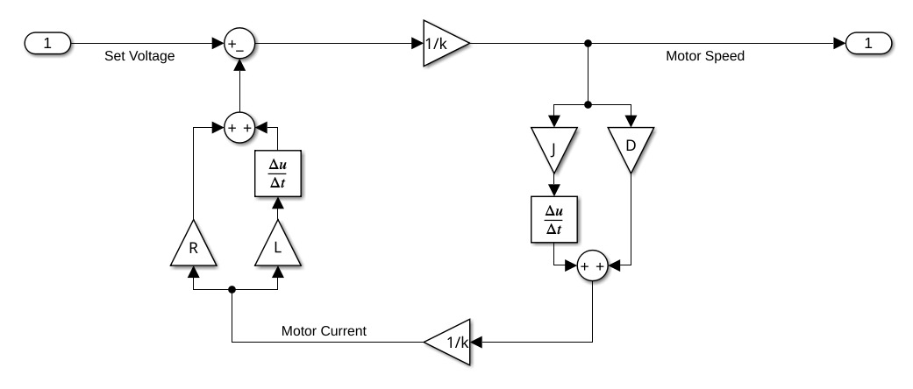
Motor Block Diagram

Slide 6
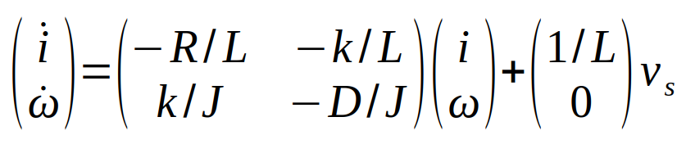
Motor Response
Motor state space was derived.
Eigenvalues analyzed for damping type and stability.
Step input analyzed for transient response, overshoot, peak time, and settling time.
Instead of constant load, a known damping term proportional to angular velocity was defined.
S-Plane poles plotted
Simulation warns if response time is not negligible.

Slide 7
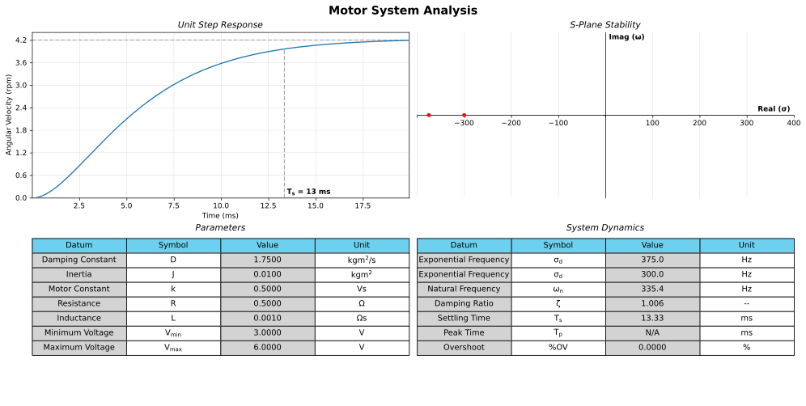

Slide 8
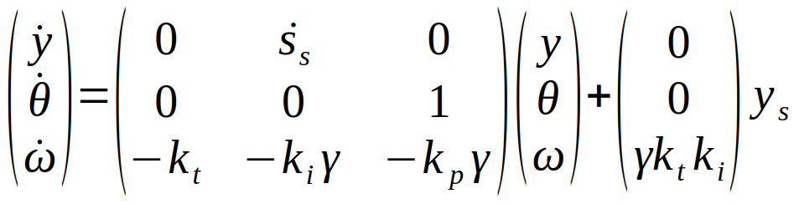
Differential System
At high errors, θe becomes saturated at ±π/2 radians.
Position analysis may be ignored, simplifying the state space into 2nd order
At low errors, sin(θ) and tanh(ktye) can be linearized as θ and ktye
Robot speed is approximately constant.

Slide 9
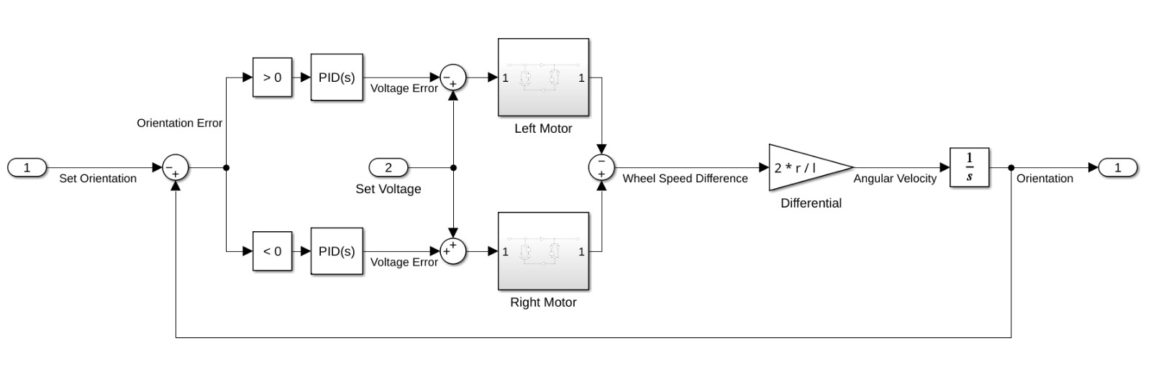
Motor Feedback

Slide 10
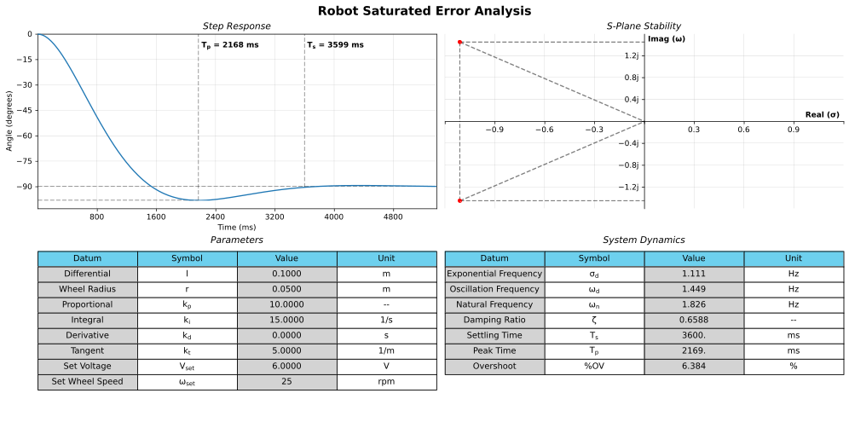

Slide 11
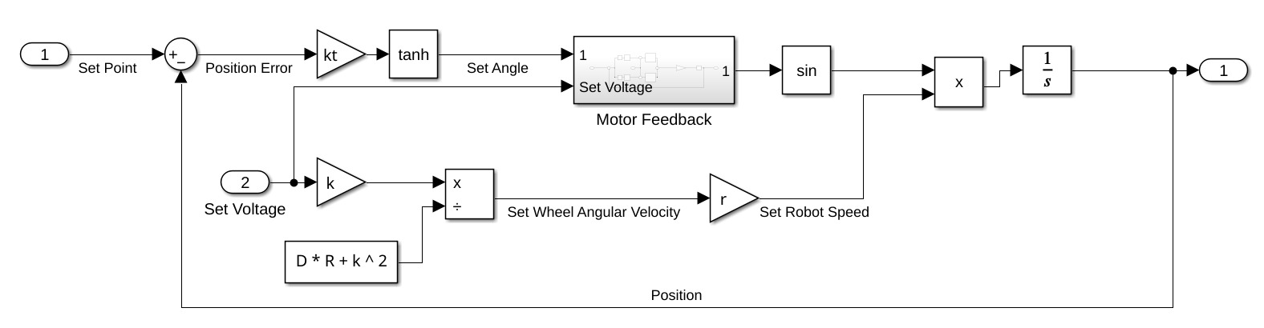
Differential Feedback

Slide 12
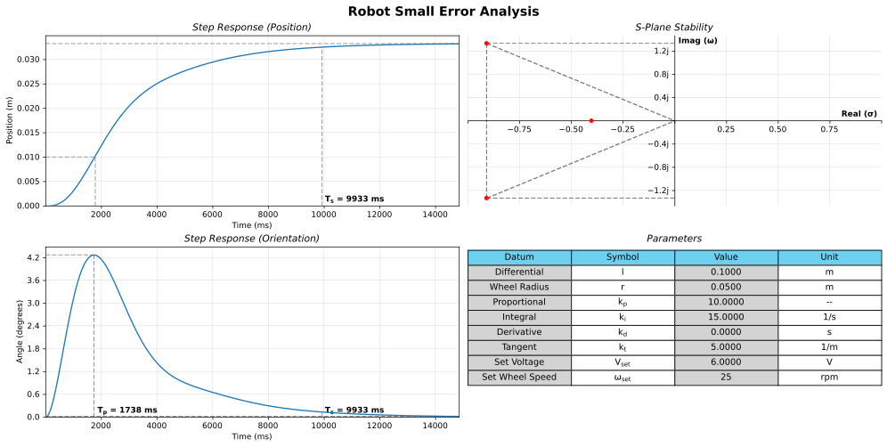

Slide 13
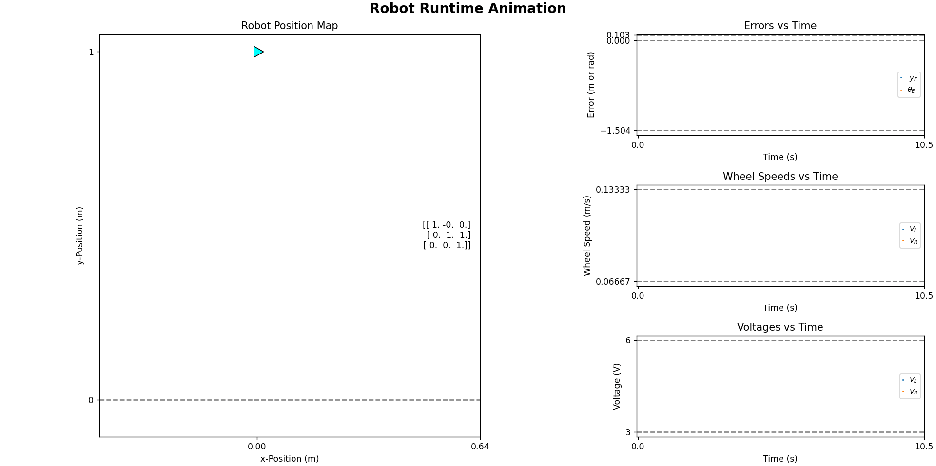
No Noise

Slide 14

Nominal Noise

Slide 15
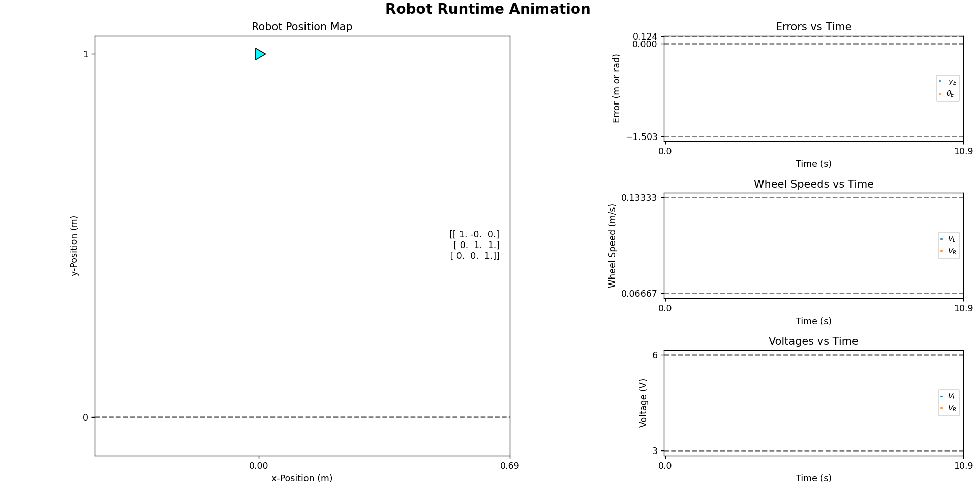
High Noise

Slide 16
Noise Comparisons
Noise Case | Noise Mean (rad/s) | Noise Deviation (Wheel Speed multiplier) | Convergence Time (s)
None | 0 | 0x | 10.5
Nominal | 0 | 1x | 10.6
High | 0 | 5x | 10.9

Slide 17
Deficiencies
The robot is slow at correcting small errors
PID and tangent constants have not been rigorously tuned
The simulator does not integrate the motor’s state, though it does raise a warning when transient response is non-negligible.
The system analyzer does not incorporate the comparator logic of the simulation’s control system.

Slide 18
References
[1] N. S. Nise, "Modeling in the Frequency Domain," in Control Systems Engineering, 6th ed. Hoboken, NJ: Wiley, 2011, ch. 2, pp. 79–84.
[2] N. S. Nise, "Modeling in the Time Domain," in Control Systems Engineering, 6th ed. Hoboken, NJ: Wiley, 2011, ch. 3, pp. 117–144.
[3] N. S. Nise, "Time Response," in Control Systems Engineering, 6th ed. Hoboken, NJ: Wiley, 2011, ch. 4, pp. 161–207.
[4] N. S. Nise, "Stability," in Control Systems Engineering, 6th ed. Hoboken, NJ: Wiley, 2011, ch. 6, pp. 301–322.

Slide 19
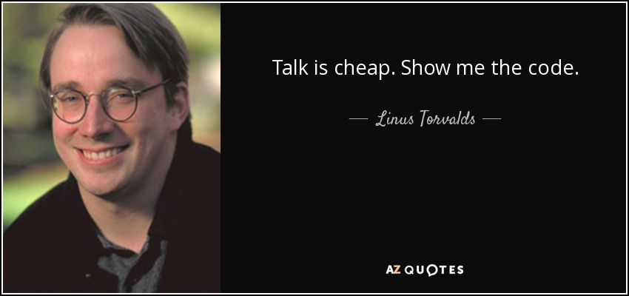
For more details...

